Slide 1
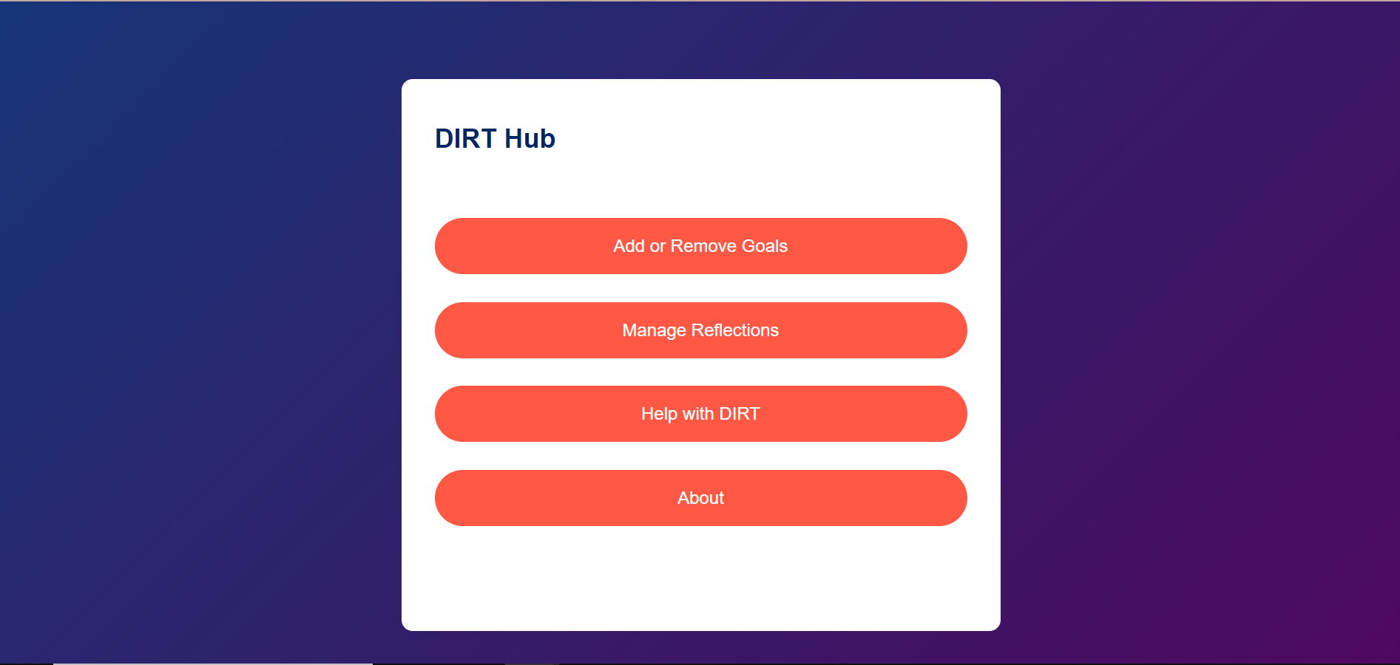
DIRT Hub – a reflection tool for students
By Ben Chapman

Slide 2
Outline
DIRT stands for Dedicated Improvement and Reflection Time. It is a strategy used in education, particularly in the UK, to enhance student learning by giving them structured time to reflect on their work, respond to feedback, and make improvements.
This project encourages students to utilise this tool by providing a convenient location for students to log reflections on their work and actionable goals so that they are able to revisit their reflections at a later date and are able to remind themselves of key things they need to remember going forwards.

Slide 3

Home Page

Slide 4
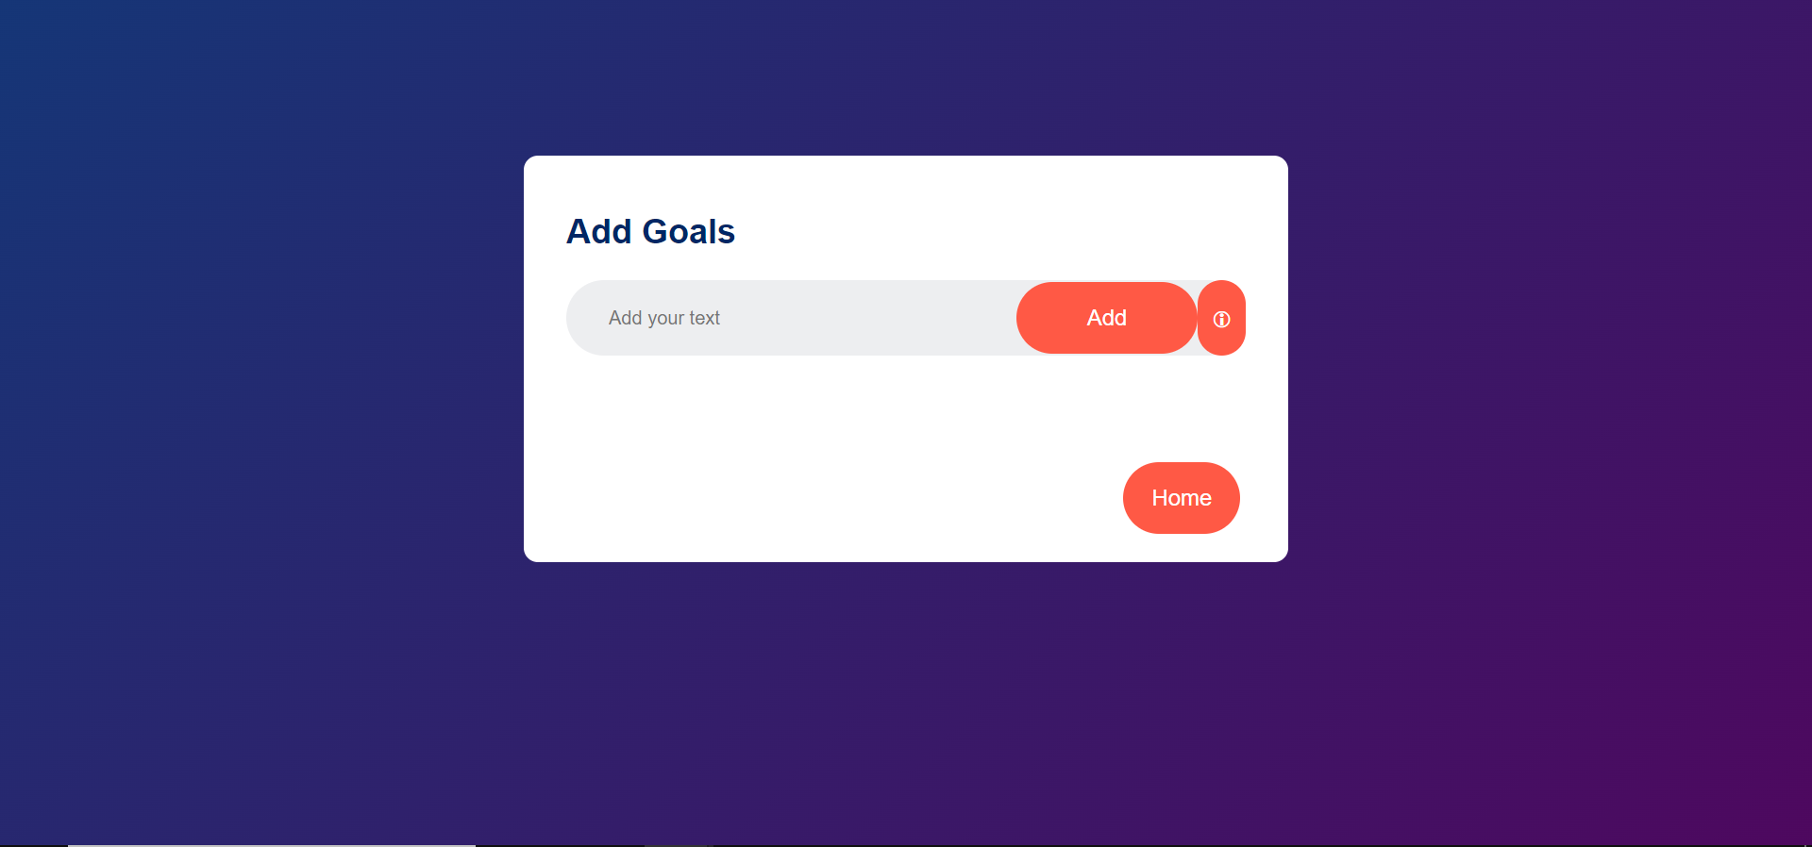
Add or Remove Goals

Slide 5
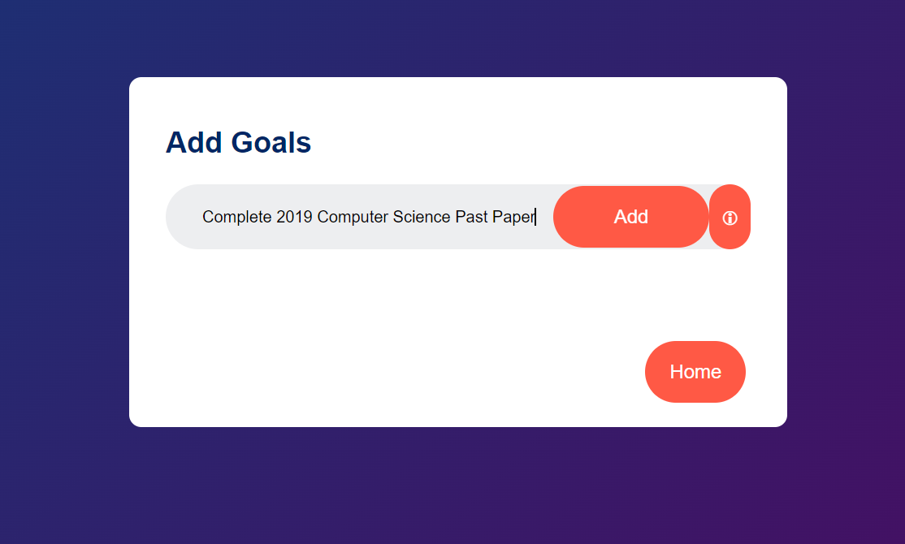
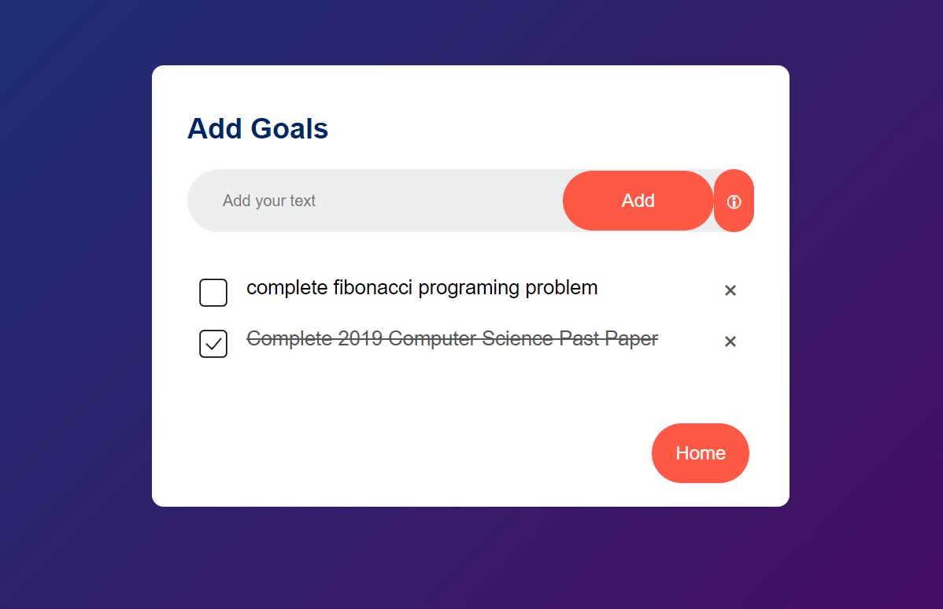
Mark goals as completed or delete them
Add new goals

Slide 6
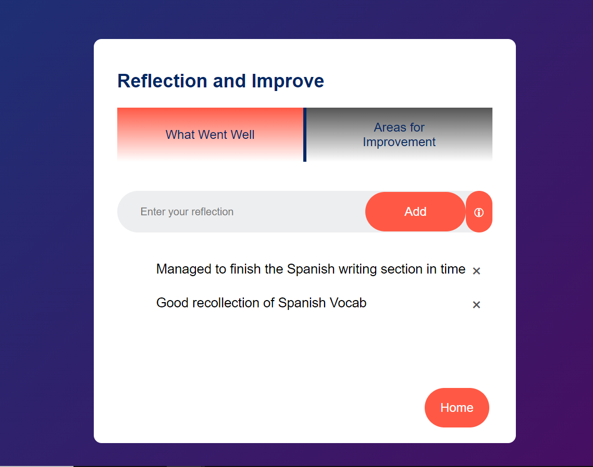
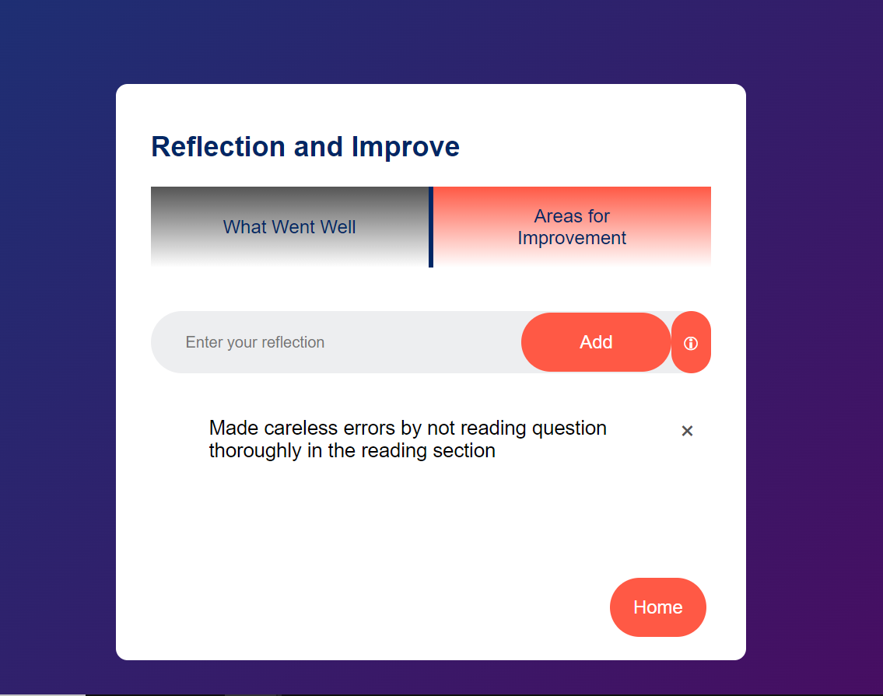
Add Reflections about Areas that Went Well
Keep Track of Areas for Improvement

Slide 7
Help Page
Defines what DIRT is.
Explains how DIRT works.
Details benefits of DIRT.
Describes how to create achievable goals.
Provides advice on how to reflect effectively.

Slide 8
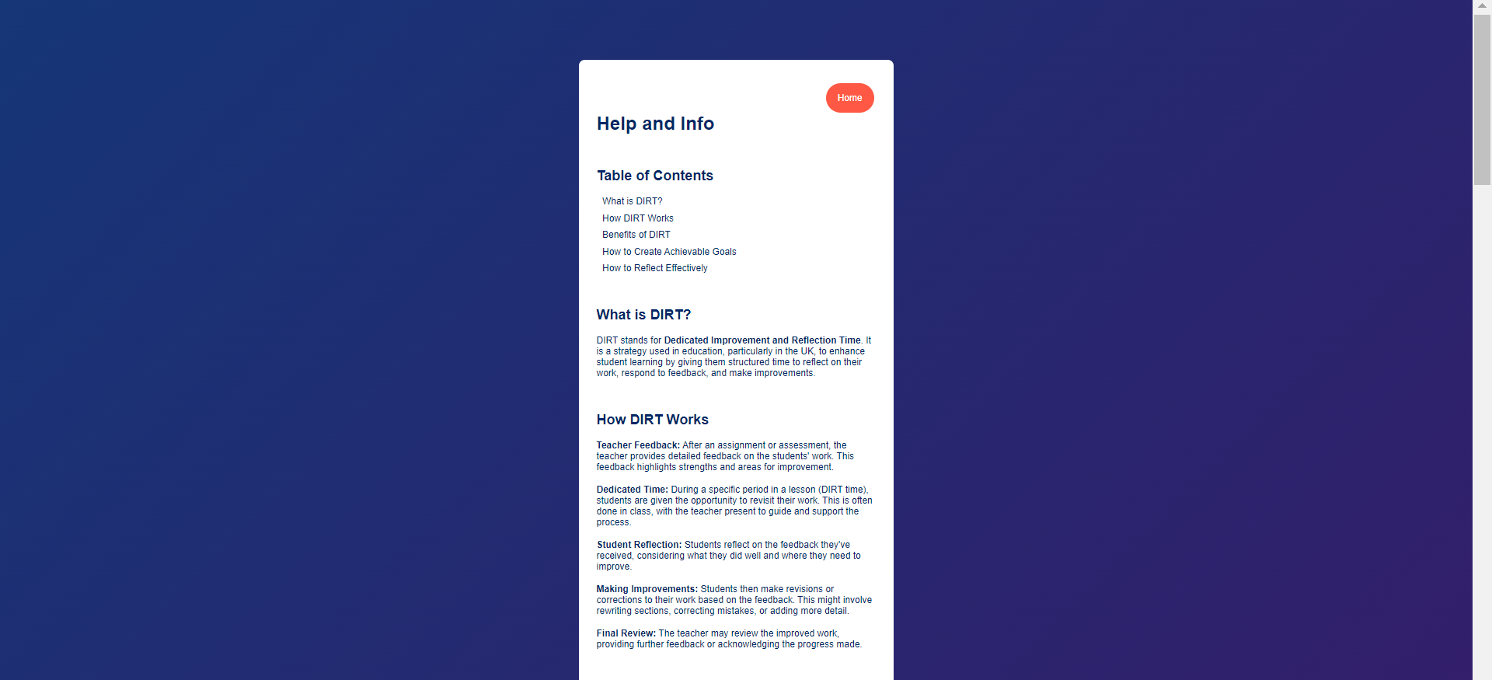
First two sections of help page:

Slide 9
This Project’s Aim
Reflecting on the results of homework and exams is an extremely key method for improving as a student.
During my time as a student, we would often not be encouraged to reflect properly on our results or if we were we would be given paper sheets that were often lost.
I aim to create a web page for students to review their past reflections and create actionable goals which they can track over time.

Slide 10
How This Project Could Impact Education
This project encourages students to reflect frequently and effectively on their work.
This project allows committed students to maximise the use of their learning time and enables students to acheive better results in exams by helping students prepare more effectively.
The tool is a prototype that could be expanded upon by implementing a log-in system for users to create an account and store their reflections server-side instead of client-side. This would allow users to manage their reflections from multiple devices.
Another potential expansion could be to add a timeline to goals and use email reminders to encourage users to meet these goal timelines.

